Slide 1

DataSprint - Hackathon
Team members: T Barath, thasshien G R, Karnaveer singh

Slide 2
Problem Statement
Problem Statement: AI-Powered HR Agent for Employee Lifecycle
Objective: Develop an AI-powered self-service HR assistant to automate key employee lifecycle tasks including onboarding, leave management, policy queries, and exit processes.
Importance: Streamlines HR operations, reduces SLA breaches, and enhances employee satisfaction through faster, automated service.
Data & Integration:
Connect with HRIS/Payroll APIs such as Workday, HRNet, and Paylocity
Integrate with company SSO for secure access
Utilize employee policy documents and internal knowledge base for accurate responses
Prototype Goal: Build a conversational user interface that handles common HR queries and automates at least two workflows (e.g., leave approval, asset issuance) using static data.

Slide 3
Softwares and technologies used
1. MERN Stack (for web app):
MongoDB → Stores employee data (leave records, policies, etc.)
Express.js → Backend server handling API requests & HR workflows
React.js → Frontend with conversational chat UI
Node.js → Runtime for backend + API integration
2. Ollama:
Local LLM server running on our machine
Provides an easy API (/api/generate) to interact with models
3. LLaMA 3 (LLM Model):
Acts as the HR assistant’s “brain”
Powers natural conversation for employee lifecycle tasks
Used for queries like onboarding help, leave management, exit process

Slide 4

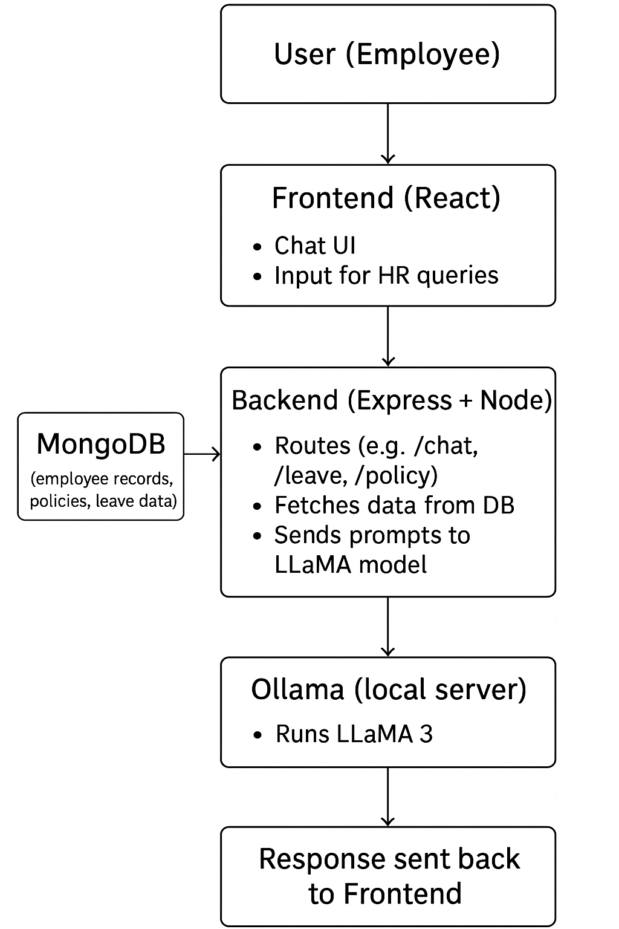
WORKFLOW
This flowchart illustrates the workflow of an AI-powered HR assistant system. It starts with the User (Employee) interacting through a React-based frontend that provides a chat interface for HR queries. The queries are sent to the Backend (Express + Node), which manages routes (like /chat, /leave, /policy), retrieves relevant data from MongoDB (employee records, policies, leave data), and forwards prompts to Ollama, running the LLaMA 3 model on a local server. The AI generates a natural language response, which is then passed back through the backend and displayed on the frontend for the employee.

Slide 5
OLLAMA
Ollama is a lightweight framework that allows you to run large language models (LLMs) like LLaMA 2/3, Mistral, Gemma, and others locally on your machine. Instead of depending on cloud-based APIs (like OpenAI or Hugging Face inference endpoints), Ollama provides a local server environment where you can load, run, and interact with models efficiently.
It’s designed to be developer-friendly, offering a simple way to serve LLMs through APIs that can easily integrate with Node.js, Python, or any backend.
Advantages of Using Ollama:
Runs Locally – No need to rely on cloud APIs; data never leaves your system.
Data Privacy & Security – Since queries and responses stay within your local environment, it’s ideal for sensitive domains like HR data.
Cost-Effective – No recurring API costs for every request, unlike cloud-based models.
Customizable Models – You can run different versions of LLAMA (or other models), fine-tune them, or switch models easily.
Offline Access – Works without internet, making it more reliable for internal company tools.
Integration Friendly – Exposes a simple API that works smoothly with your Express + Node backend.

Slide 6
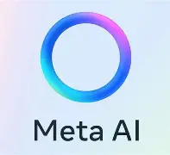
LLAMA3
Llama 3 is the latest generation large language model (LLM) developed by Meta AI, designed for a broad range of natural language processing tasks with state-of-the-art performance. It comes in pretrained and instruction-fine-tuned variants with 8 billion and 70 billion parameters, making it powerful for understanding and generating human-like text.
Why use Llama3?
Llama 3 is used in conversational AI chatbots, content generation, coding assistance, data analysis, language translation, and education. It helps build AI tools that understand and respond naturally, making it valuable for our project.

Slide 7
WHAT WE HAVE DONE SO FAR
Frontend with a clean, intuitive UI for a seamless employee experience
Secure login area ensuring only authorized company employees can access sensitive HR data
JWT tokens implemented for robust authentication and session management
Backend is operational, handling login processes, authentication checks, and API requests
MongoDB with static database
AI-powered HR chatbot fully integrated with the system
Chatbot handles a wide range of employee queries, including:
Working hours & remote work policies:
Expenses and benefits
Emergency contacts
HR and conduct guidelines
IT-related questions
Exit policies
System ensures security, efficiency, and streamlined HR operations
Provides employees with instant and accurate responses

Slide 8

Why is Our HR Assistant Efficient & Effective
Intuitive Frontend: React UI provides seamless interaction → employees quickly submit requests & access policies.
Secure Access: SSO + JWT ensures only authorized employees access sensitive HR data → data privacy & compliance.
Backend Automation: Node.js + Express handles authentication, API requests, and workflows efficiently → reduces manual HR intervention.
AI-Powered Chatbot: Ollama + Llama 3 answers queries instantly (leave, working hours, benefits, HR/IT policies, exit processes) → minimizes SLA breaches.
Workflow Automation: Automates key processes (leave approval, asset issuance) → faster approvals, less HR workload.
Scalable & Future-Ready: Architecture allows integration with real HRIS/Payroll APIs, handles more workflows, and supports more users.
Impact: Streamlines HR operations, improves employee satisfaction, centralizes knowledge, and provides instant, accurate responses.

Slide 9
